Slide 1

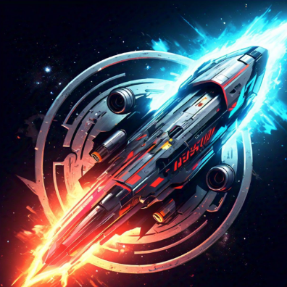
WELCOME
TO OUR DEMONSTRATION

Slide 2
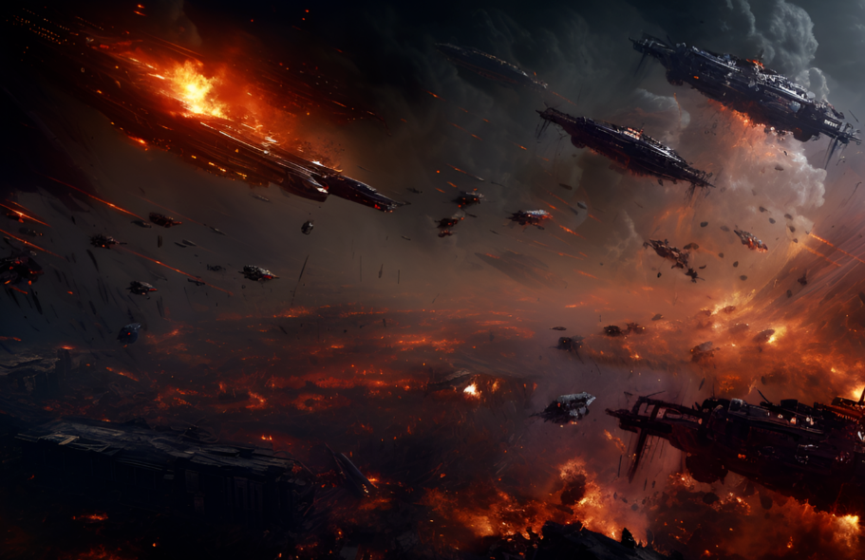
SPACE WAR GAME

Slide 3
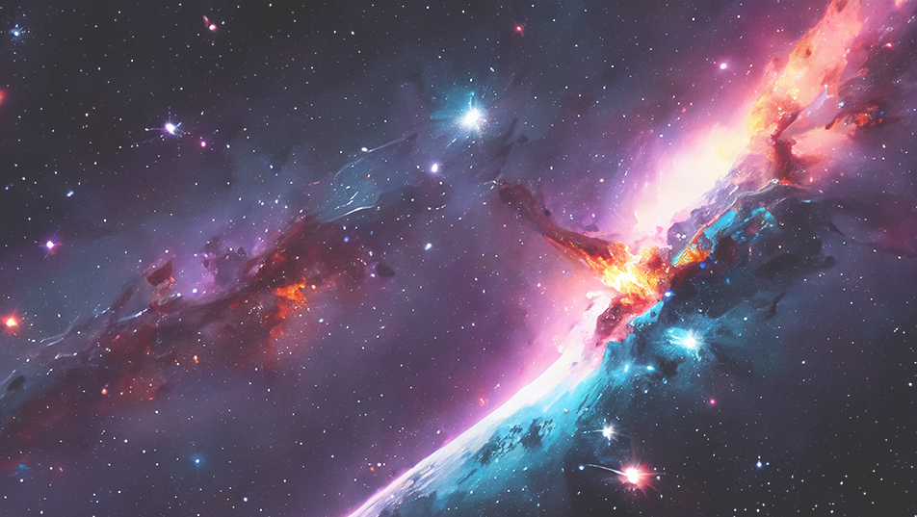
OVERVIEW:
The game was developed utilizing the “Python programming language”, in conjunction with the “Pygame library”, on the Windows operating system. The results of this project demonstrate that the game is fully functional and meets the required specifications.

Slide 4
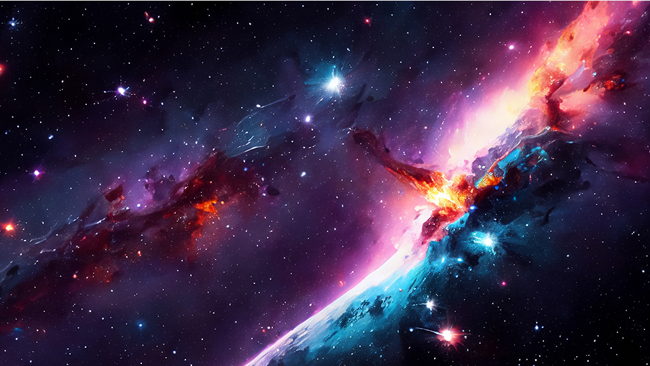
Players are tasked with guiding their spaceship through a hazardous asteroid field, where the slightest miscalculation can result in a catastrophic collision. The game demands quick reflexes, strategic thinking, and a steady hand, as players must expertly maneuver their spaceship to avoid incoming asteroids while simultaneously targeting and destroying them. With each successful destruction of an asteroid, players earn points, which are displayed on a scoreboard. The game continues until the player's spaceship collides with an asteroid, at which point the game ends, and the final score is displayed.

Slide 5
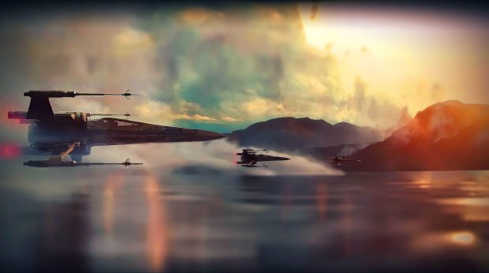
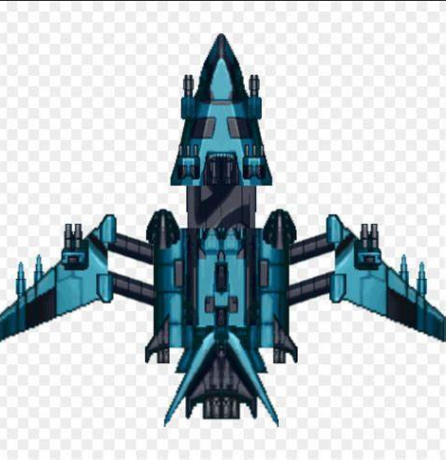

GAME FEATURES:
1.Player Movement:
The player's spaceship can be moved left and right using the arrow keys.

Slide 6
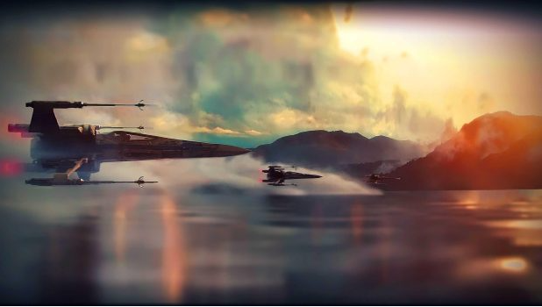
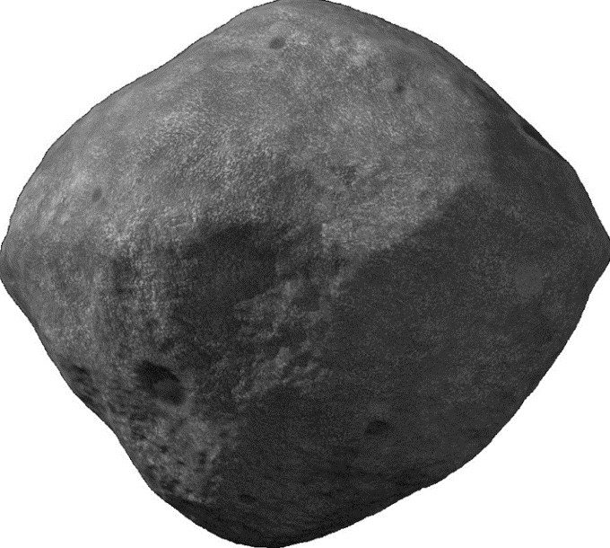
2.Bullet shooting:
The player can shoot bullets at incoming asteroids using the spacebar.
3.Asteroid Spawning:
Asteroids are randomly generated and move towards the player's spaceship..

Slide 7
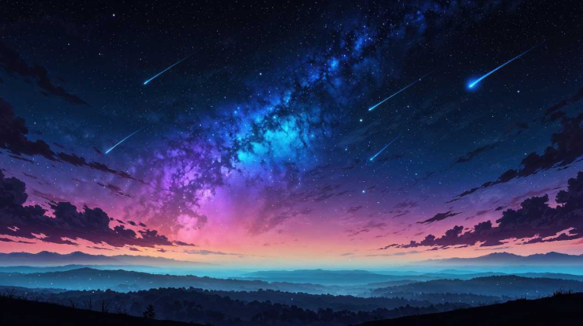
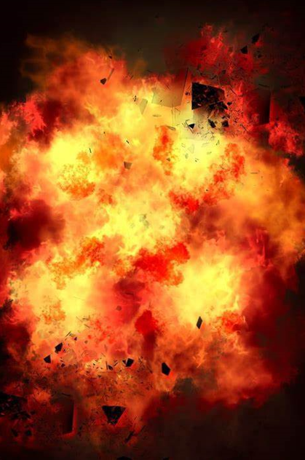
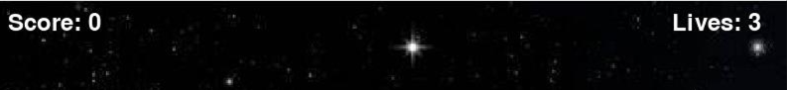
4.Collision Detection:
Collisions between the bullets, asteroids, and the player's spaceship are detected, and the game responds accordingly.
5.Scoring System:
The player earns points for destroying asteroids, and loses lives when colliding with asteroids.
Like this:

Slide 8
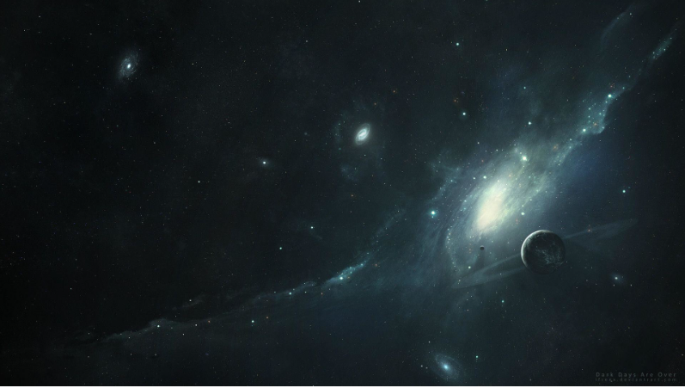
Challenges:
Optimizing game performance for smoother gameplay was a significant challenge. The game required optimization to:
1.Achieve a consistent frame rate 2.Reduce lag and shuttering Improve overall gaming experience .
To address this challenge, the following strategies were employed:
1:Optimized game loops and event handling .
2:Implemented efficient rendering techniques, such as batch rendering.
3:Used Pygame's built-in optimization features, such as pygame,display_set_mode() with the HWSURFACE flag

Slide 9

Initializing Libraries And Defining Constants:
# Importing necessary libraries
import pygame
import random
from collections import deque
# Initializing pygame
pygame.init()
# Defining constants for screen width & height
SCREEN_WIDTH = 800
SCREEN_HEIGHT = 600
# Setting the caption of the game window
pygame.display.set_caption("Space Shooter")
# Defining Constants for colours
WHITE = (255, 255, 255)
BLACK = (0, 0, 0)

Slide 10
Rest of the code is:
# Loading game assets(images)
spaceship_image = pygame.image.load("C:/Users/LAIBA/Pictures/spaceship.jpg")
spaceship_image = pygame.transform.scale(spaceship_image, (60, 60))
ally_image = pygame.image.load("C:/Users/LAIBA/Pictures/ally.jpg")
ally_image = pygame.transform.scale(ally_image, (60, 60))
bullet_image = pygame.image.load("C:/Users/LAIBA/Pictures/bullet.jpg")
bullet_image = pygame.transform.scale(bullet_image, (5, 10))
asteroid_image=pygame.image.load("C:/Users/LAIBA/Pictures/asteroid.jpg")
asteroid_image pygame.transform.scale(asteroid_image, (50, 50))
explosion_image=pygame.image.load("C:/Users/LAIBA/Pictures/explosion.jpg")
explosion_image = pygame.transform.scale(explosion_image, (60, 60))
background_image=pygame.image.load("C:/Users/LAIBA/Pictures/background.jpg")
background_image = pygame.transform.scale(background_image, (SCREEN_WIDTH, SCREEN_HEIGHT))
# Initializing Sound Mixer
pygame.mixer.init()
# Loading Sound Effects
fire_sound = pygame.mixer.Sound("C:/Users/LAIBA/Pictures/laser-gun.wav")
explosion_sound = pygame.mixer.Sound("C:/Users/LAIBA/Pictures/explosion.wav")
# Initializing Game variables
spaceship_x = SCREEN_WIDTH // 2
spaceship_y = SCREEN_HEIGHT – 80

Slide 11
spaceship_speed = 5
ally_x = SCREEN_WIDTH // 4
ally_y = SCREEN_HEIGHT – 80
ally_speed = 5
lives = 5
score = 0
# Creating a font object
font = pygame.font.Font(None, 36)
#Initialize bullet, asteroid,explosion,allies, ally_bullets lists
bullets = deque()
asteroids = deque()
explosions = []
allies = [[ally_x, ally_y]]
ally_bullets = []
# Initializing Game difficulty variable
shit_count = 0
asteroid_speed = 5
spawn_interval = 50
# Creating Clock Object clock = pygame.time.Clock()
# Defining Functions to draw game objects
def draw_bullets():
for bullet in bullets:
screen.blit(bullet_image, (bullet[0], bullet[1]))
def draw_asteroids():
for asteroid in asteroids:

Slide 12
screen.blit(asteroid_image, (asteroid[0], asteroid[1]))
def draw_explosions():
for explosion in list(explosions):
screen.blit(explosion_image, (explosion[0], explosion[1]))
explosion[2] -= 1
if explosion[2] <= 0:
explosions.remove(explosion)
def draw_allies():
for ally in allies:
screen.blit(ally_image, (ally[0], ally[1]))
def display_lives():
lives_text = font.render(f"Lives: {lives}", True, WHITE)
screen.blit(lives_text, (SCREEN_WIDTH - 120, 10))
# Initializing screen screen=pygame.display.set_mode((SCREEN_WIDTH, SCREEN_HEIGHT))
pygame.display.set_caption("Space Shooter")
# Game loop running = True
while running:
# Handling Events for event in pygame.event.get():
if event.type == pygame.QUIT:
running = False
#Get key presses keys = pygame.key.get_pressed()
if keys[pygame.K_LEFT] and spaceship_x > 0:
spaceship_x -= spaceship_speed
if keys[pygame.K_RIGHT] and spaceship_x < SCREEN_WIDTH - 60:
spaceship_x += spaceship_speed

Slide 13
if keys[pygame.K_SPACE]:
bullets.append([spaceship_x + 25, spaceship_y])
fire_sound.play()
# Ally shoots bullets for ally in allies:
for asteroid in asteroids:
if abs(ally[0] - asteroid[0]) < 200 and abs(ally[1] - asteroid[1]) < 200:
if random.randint(1, 100) < 10: # 10% chance of firing
ally_bullets.append([ally[0] + 25, ally[1]])
fire_sound.play()
# Move allies for ally in allies:
if keys[pygame.K_a] and ally[0] > 0:
ally[0] -= ally_speed
if keys[pygame.K_d] and ally[0] < SCREEN_WIDTH - 60:
ally[0] += ally_speed
if keys[pygame.K_w] and ally[1] > 0:
ally[1] -= ally_speed
if keys[pygame.K_s] and ally[1] < SCREEN_HEIGHT - 60:
ally[1] += ally_speed
# Update bullets for bullet in bullets:
bullet[1] -= 10
bullets = deque([bullet for bullet in bullets if bullet[1] > 0])
#Update Ally bullets for bullet in ally_bullets:
bullet[1] -= 10
ally_bullets = [bullet for bullet in ally_bullets if bullet[1] > 0]

Slide 14
# Spawn asteroids if random.randint(1, spawn_interval) == 1:
asteroids.append([random.randint(0, SCREEN_WIDTH - 50), -50])
# Update asteroids for asteroid in asteroids:
asteroid[1] += asteroid_speed
asteroids = deque([asteroid for asteroid in asteroids if asteroid[1] < SCREEN_HEIGHT])
# Check collisions for bullet in list(bullets):
for asteroid in list(asteroids):
if (bullet[0] < asteroid[0] + 50 and
bullet[0] + 10 > asteroid[0] and
bullet[1] < asteroid[1] + 50 and
bullet[1] + 30>asteroid[1]):
bullets.remove(bullet)
asteroids.remove(asteroid)
score += 10
hit_count += 1
explosion_sound.play()
explosions.append([asteroid[0], asteroid[1], 30])
# Check collisions for ally bullets
for bullet in list(ally_bullets):
for asteroid in list(asteroids):
if (bullet[0] < asteroid[0] + 50 and
bullet[0] + 10 > asteroid[0] and
bullet[1] < asteroid[1] + 50 and
bullet[1] + 30 > asteroid[1]):
ally_bullets.remove(bullet)

Slide 15
asteroids.remove(asteroid)
explosion_sound.play()
explosions.append([asteroid[0], asteroid[1], 30])
# Increase difficulty
if hit_count >= 10:
asteroid_speed = 7
spawn_interval = 40
# Check for spaceship collisions
for asteroid in list(asteroids):
if (spaceship_x < asteroid[0] + 50 and
spaceship_x + 60 > asteroid[0] and
spaceship_y < asteroid[1] + 50 and
spaceship_y + 60 > asteroid[1]):
asteroids.remove(asteroid)
lives -= 1
explosion_sound.play()
explosions.append([spaceship_x, spaceship_y, 30])
# Check for ally collisions
for ally in allies:
for asteroid in list(asteroids):
if (ally[0] < asteroid[0] + 50 and
ally[0] + 60 > asteroid[0] and
ally[1] < asteroid[1] + 50 and
ally[1] + 60 > asteroid[1]):
asteroids.remove(asteroid)

Slide 16
lives -= 1
explosion_sound.play()
explosions.append([ally[0], ally[1], 30])
# Game over
if lives == 0:
running = False
# Draw everything
screen.blit(background_image, (0, 0))
screen.blit(spaceship_image, (spaceship_x, spaceship_y))
draw_bullets()
for bullet in ally_bullets:
screen.blit(bullet_image, (bullet[0], bullet[1]))
draw_asteroids()
draw_explosions()
draw_allies()
# Display score and lives
score_text = font.render(f"Score: {score}", True, WHITE)
screen.blit(score_text, (10, 10))
display_lives()
# Update display
pygame.display.flip()
# Cap the frame rate
clock.tick(60)

Slide 17
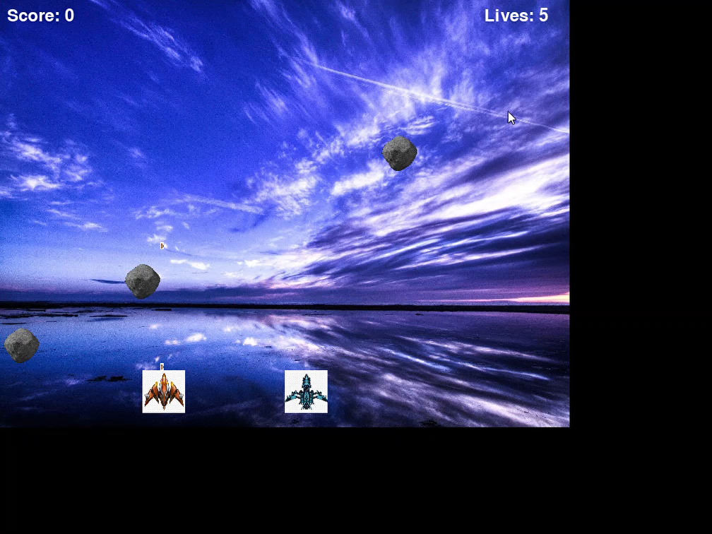

Slide 18

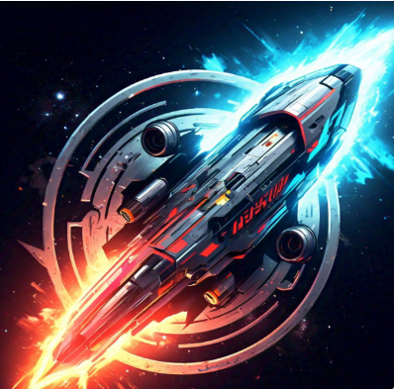
"Engage in a War that's Out of this World"

